Slide 1
Understanding Bicycle Theft Risk:
Drawing Correlations Between Bicycle Cost and Risk of Theft Based on Location & Time Factors
CST8390 – 011 Group Project
Meet Ahalpara
Nataliya Burlakov
Krish Patel
Joseph Riel
March 30, 2025

Slide 2
Introduction
Bicycle theft is a common urban issue; identifying patterns and risk factors can help prevent crimes.
This study analyzes Toronto Police Service bicycle theft data to uncover trends and risk factors.
The dataset includes details like date, time, location, and bicycle attributes (adjusted for privacy).
Various data models (KNN, Decision Trees, Clustering, Outlier Detection) are applied to identify key theft factors.

Slide 3
Our Presentation
Will be structured based on the Cross-Industry Standard Process for Data Mining (CRISP-DM)

Slide 4
2.0 Business Understanding
In this section we’ll run you through:
What our business objectives are
Assess the ongoing bike-theft situation in Toronto area
Will not include the greater Toronto area (GTA: Markham, Vaughan, Kitchener, etc.)
What our data mining goals were

Slide 5
Business Objectives
Analyze bicycle theft incidents reported by the Toronto Police Service (2014-2024)
Identify patterns in theft locations, times, and bicycle attributes.
Support crime prevention and bike recovery efforts through data-driven insights.

Slide 6
The Situation – Data Resources
Availability of Resources
Toronto Police Service Open Data Portal provides theft data
Dataset includes theft locations, bike types, premises, and case statuses.
Dataset covers 10 years, spanning 2014-2024
Details theft locations, bike types, cost, and whether the case was resolved/not resolves

Slide 7
The Situation – Bike Theft Risks
Key Risks in Toronto Bicycle Theft are:
High-Theft Locations – Outdoor spaces and apartment buildings have higher incidents.
Bike Value & Targeting – Expensive bikes may be stolen more frequently.
Seasonal Trends – Warmer months see increased bike theft (obviously).

Slide 8
The Situation – Data Mining Goals
Our data mining goals were:
Identify high-risk locations and peak theft times.
Classify theft risk based on bike cost (Low, Medium, High).
Detect & visualize unusual theft patterns using outlier detection & decision tree modelling.
Provide data to develop predictive models for theft hotspots and prevention strategies.

Slide 9
3.0 Data Understanding
In this section we will briefly
Talk about the initial data collected
Describe our Data
Explore the data with visualizations
Verify Data Quality

Slide 10
Data Collected
Dataset from Toronto Police Service Open Data Portal (2014-2024).
Bicycle Thefts - City of Toronto Open Data Portal
The dataset was initially provided as a CSV file.
Includes:
Reported bicycle thefts
Theft locations and times
Bike details (make, model, color, value)
Premises type (e.g., apartment, transit station, home)
Status (Stolen, Recovered, Unknown)

Slide 11
Data Collected Cont.
Key Considerations during data collection:
The dataset does not include occurrences that have been deemed unfounded.
The location of crime occurrences has been deliberately offset to the nearest road intersection node to protect the privacy of parties involved in the occurrence.
Some records may not have been fully verified at the time of publication.

Slide 12
Verify Data Quality
Data was checked for duplicates, and were removed
Sample of 10 000 records were taken
BIKE_COST attribute was categorized (binned) into 3 categories (Low, Medium, High) depending on their cost (Low < $500, Medium <= $1000, High > $1001) and BIKE_COST_CLASS column was created.

Slide 13
Describe Data
Attributes | Description | DataType
_id | Unique row identifier for Open Data database | Integer
EVENT_UNIQUE_ID | Offence Number | Polynominal
PRIMARY_OFFENCE | Primary Offence Type | Polynominal
OCC_DATE | Date of Offence | Date
OCC_YEAR | Year Offence Occurred | Integer
OCC_MONTH | Month Offence Occurred | Polynominal
OCC_DOW | Day of the Month Offence Occurred | Polynominal
OCC_DAY | Day of the Year Offence Occurred | Integer

Slide 14
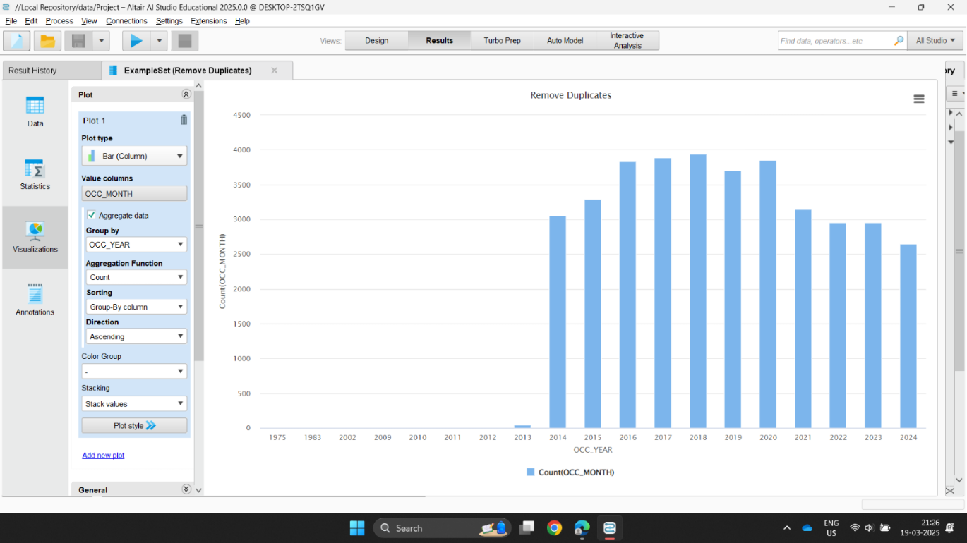
Explore Data
Incidents peaked between 2016 and 2018, showing a higher number of reported cases during those years.

Slide 15
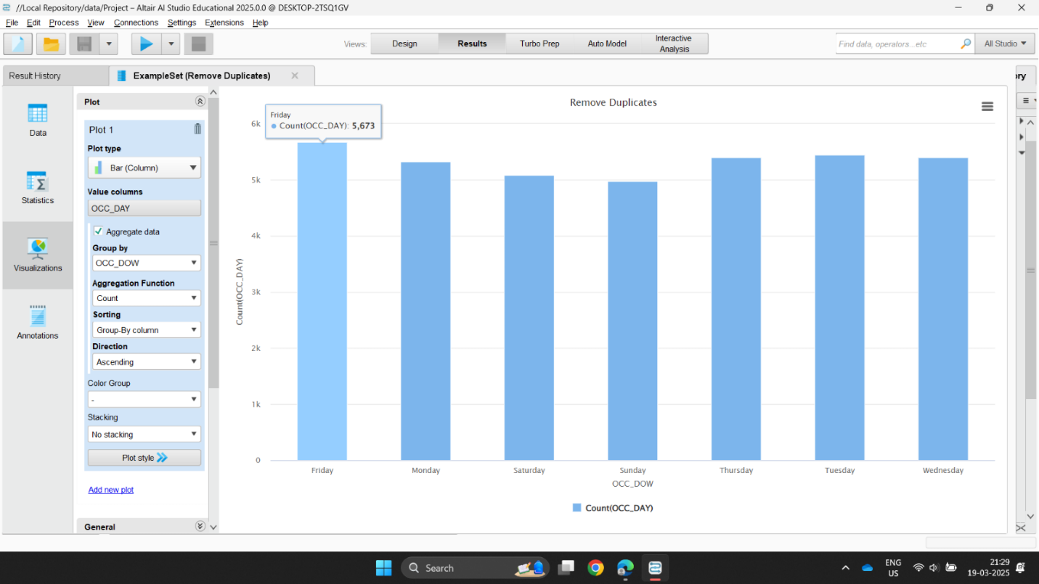
Explore Data
Fridays recorded the most incidents, suggesting increased theft or accident activity closer to the weekend.

Slide 16
Verify Data
Attribute Name | Number of Missing Values/ Duplicates | Data Quality Issue | Data Preparation Step
_id | 399 Duplicates | Duplicate records | Removed duplicates by excluding _id
EVENT_UNIQUE_ID | 2 Duplicates (if _id excluded) | Minor duplicate records | Removed duplicates by excluding EVENT_UNIQUE_ID
PRIMARY_OFFENCE | 0 | No issues | No changes required
OCC_DATE | 0 | No issues | No changes required
OCC_YEAR | 0 | No issues | No changes required
OCC_MONTH | 0 | No issues | No changes required
OCC_DOW | 0 | No issues | No changes required
OCC_DAY | 0 | No issues | No changes required

Slide 17
Describe Data Cont.
Attributes | Description | DataType
OCC_DOY | Day of the year when offence occurred | Integer
OCC_HOUR | Hour of the day when offence occurred | Integer
REPORT_DATE | Date when offence was reported | Date
REPORT_YEAR | Year when offence was reported | Integer
REPORT_MONTH | Month when offence was reported | Polynominal
REPORT_DOW | Day of the week when offence was reported | Polynominal
REPORT_DAY | Day of the year when offence was reported | Integer

Slide 18
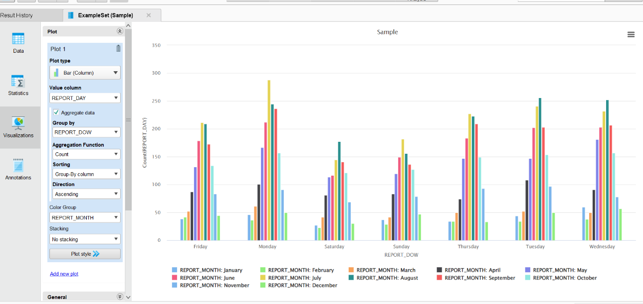
Explore Data
Most theft reports happen on weekdays across all months, with July and August showing consistently higher counts than other months.

Slide 19
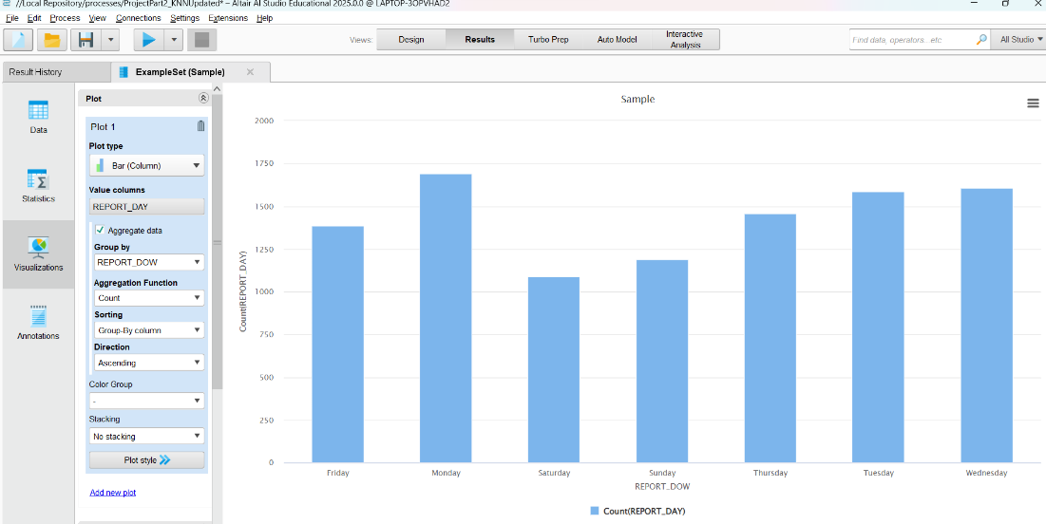
Explore Data
More bicycle thefts are reported on weekdays, especially Monday to Wednesday, while weekends have fewer reports.

Slide 20
Verify Data
Attribute Name | Number of Missing Values / Duplicates | Data Quality Issue | Data Preparation
OCC_DOY | 0 missing | No issues | No changes required
OCC_HOUR | 0 missing | No issues | No changes required
REPORT_DATE | 0 missing | No issues | No changes required
REPORT_YEAR | 0 missing | No issues | No changes required
REPORT_MONTH | 0 missing | No issues | No changes required
REPORT_DOW | 0 missing | No issues | No changes required
REPORT_DAY | 0 missing | No issues | No changes required

Slide 21
Describe Data Cont.
Attribute name | Description | Datatype
REPORT_DOY | Day of the Year Offence was Reported | Numerical
REPORT_HOUR | Hour when Offence was Reported | Numerical
DIVISION | Police Division where Offence Occurred | Nominal
LOCATION_TYPE | Location Type of Offence | Nominal
PREMISES_TYPE | Premises Type of Offence | Nominal
BIKE_MAKE | Make of Bicycle | Nominal
BIKE_MODEL | Model of Bicycle | Nominal
BIKE_TYPE | Type of Bicycle | Nominal

Slide 22
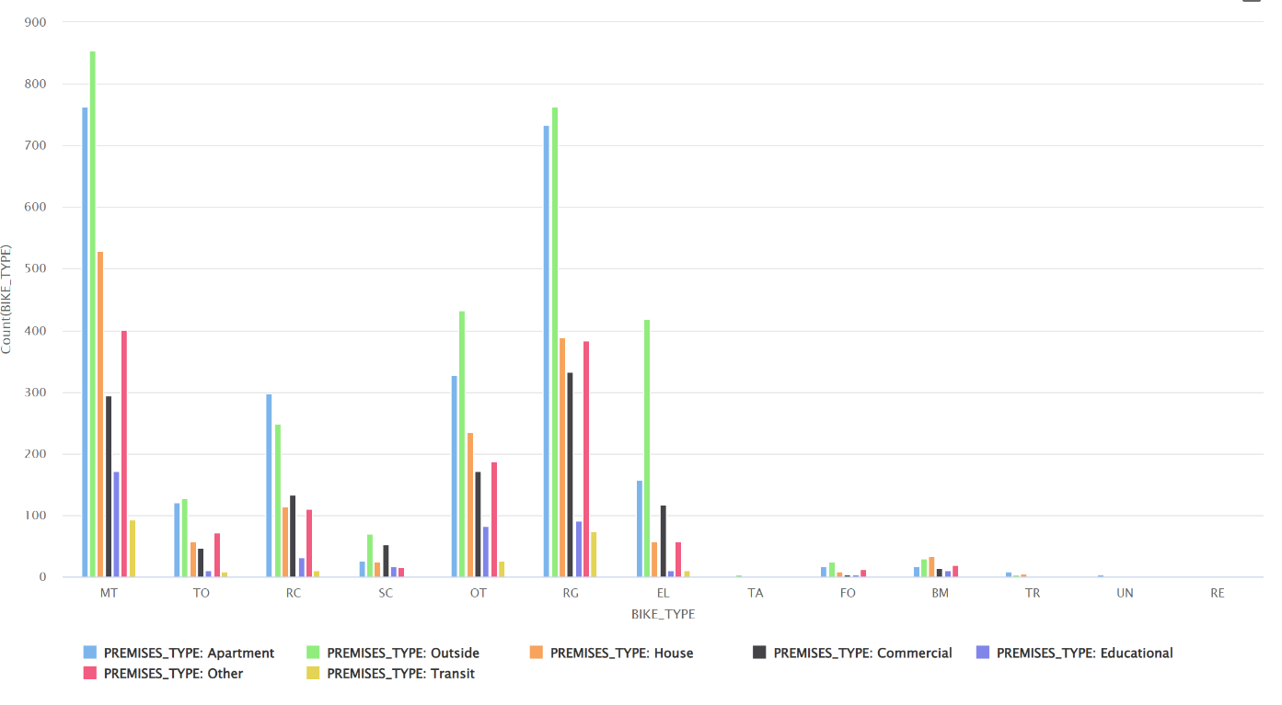
Explore Data
Some bike types (MT, RG) are stolen more often than others.
Outside locations and apartments account for the highest theft counts.
Educational and transit premises have lower theft rates.

Slide 23
Verify Data
Attribute name | Number of Missing Values | Data Quality Issue | Data Preparation
REPORT_DOY | 0 | No issues
REPORT_HOUR | 0 | No issues
DIVISION | 0 | No issues
LOCATION_TYPE | 0 | No issues
PREMISES_TYPE | 0 | No issues
BIKE_MAKE | 0 | “?” | Replaced by “UNKNOWN”
BIKE_MODEL | 3 | “?” “None” inconsistent representation | Replaced by “UNKNOWN” Replaced by “NONE” Missing data replaced by “UNKNOWN”
BIKE_TYPE | 4 | No issues | Missing data replaced by “UNKNOWN”

Slide 24
Describe Data Cont.
Attribute Name | Description | Datatype
BIKE_SPEED | Speed of Bicycle | Numerical
BIKE_COLOUR | Colour of bicycle | Nominal
BIKE_COST | Cost of bicycle (assumed in CAD) | Numerical
STATUS | Status of bicycle (Stolen, Recovered, Unknown) | Nominal
LONG_WGS84 | Longitude coordinate | Numerical
LAT_WGS84 | Latitude coordinate | Numerical
geometry | Unknown JSON object | Nominal

Slide 25
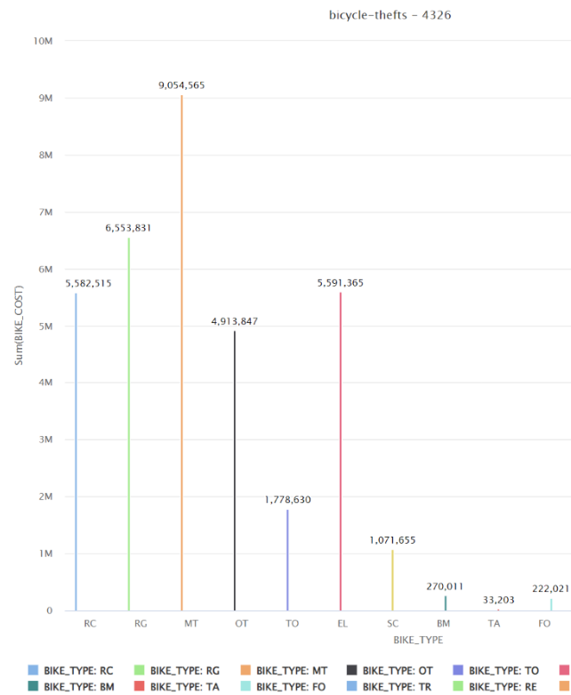
Visually Explore Data
Mountain bikes (MT) and Road/Gravel (RG) bikes are by far the most stolen bikes
Combined total value of Mountain/Road bikes is $15,608,386
Accounts for nearly half of the value of all bike thefts

Slide 26
Verify Data
Attribute Name | Missing Values | Data Quality Issue | Data Preparation
BIKE_SPEED | 1296 | “?” | Replaced with “UKNOWN”
BIKE_COLOUR | 15 | “?” “NONE” | Replaced with “UNKNOWN” because there is already “UNKNOWN” value
BIKE_COST | 4365 | “?” | Replaced with Average
STATUS | 15 | “?” | Replaced with “UNKNOWN”
LONG_WGS84 | 348 | “?” | Replaced with Average
LAT_WGS84 | 348 | “?” | Replaced with Average
Geometry | 15 | Unusable | Removed geometry Attribute

Slide 27
k Nearest Neighbour (kNN)

Slide 28
4.0 Data Preparation (kNN Model)
Distance-based classification method.
Predicts class labels by comparing a data point to its closest neighbours.
Project Goal:
Classify bike cost category (Low, Medium, High) based on:
Bike characteristics (e.g., make, model, speed, color)
Theft context (e.g., location, division, time)
Time of occurrence (e.g., hour, month, season)
Objective:
Detect meaningful theft patterns to:
Anticipate likelihood of a bike falling into a certain cost group.
Support crime prevention and investigation strategies.

Slide 29
Data Selected (kNN)
This was the relevant data selected for the kNN.
Attribute | Description | Relevance
OCC_YEAR | Helps detect long-term shifts in bike value over years | Relevant
OCC_MONTH | Can show seasonal trends in high- or low-cost bike theft | Relevant
OCC_HOUR | Important to know if cost varies by time (night/day) | Relevant
DIVISION | Tested and improve model | Relevant
PREMISES_TYPE | Indicates theft context (e.g., private vs. public) | Relevant
BIKE_MAKE | Brand is strongly tied to value/cost of bike | Relevant
BIKE_TYPE | Type (mountain, road) affects cost | Relevant
BIKE_SPEED | Higher-speed bikes often mean higher cost | Relevant
BIKE_COLOUR | Slight relevance; kept for visual value cues | Relevant
BIKE_COST_CLASS | Target variable (Low, Medium, High) | Relevant
STATUS | May show if bike was recovered, included for testing | Relevant

Slide 30
Data Constructed (kNN)
These were the attributes constructed from the selected data
No need for the data integration
Attribute | Description | Source Attribute
OCC_DAY_TIME | Categorizes OCC_HOUR into 4 periods: Morning, Afternoon, Evening, Night to capture time-of-day patterns in bike thefts. | OCC_HOUR
OCC_SEASON | Categorizes OCC_MONTH into 4 seasons: Winter, Spring, Summer, and Fall, to help the model identify seasonal theft patterns. | OCC_MONTH

Slide 31
Data Formatted (kNN)
Numerical attributes:
BIKE_SPEED: Normalized to a common scale to ensure no single attribute has a stronger influence due to its range.
OCC_YEAR: Normalized to ensure all numerical attributes are on the same scale for comparison.
Categorical attributes:
BIKE_TYPE: Converted from categorical to numerical using Nominal to Numerical encoding. This helps in distinguishing between different types of bikes, which affect the bike's cost.
PREMISES_TYPE: Converted into a numerical format to capture the context of the theft (e.g., public vs. private areas).
OCC_DAY_TIME: Created by categorizing OCC_HOUR into time slots: Morning, Afternoon, Evening, and Night. This captures patterns in theft occurrences during different times of the day.
OCC_SEASON: Grouped OCC_MONTH into four seasons (Winter, Spring, Summer, Fall) to capture seasonal trends in bike thefts.
Target attribute:
BIKE_COST_CLASS: Set as the class label for classification, indicating the bike's cost category (Low, Medium, High).

Slide 32
5.0 Modelling (kNN)
Algorithm: k-NN is a supervised machine learning algorithm that classifies data based on the k closest neighbors in the feature space.
Objective: Classify stolen bicycles into cost categories (Low, Medium, High) based on bike features and theft context.
Distance Metric: Euclidean distance is used to measure similarity between data points.
Suitability: Ideal for datasets with mixed numerical and categorical features, after conversion, where classification depends on similarity.

Slide 33
Generate Test Design (kNN)
Testing Method:
To find the optimal value for k in the k-NN algorithm, the Optimize Parameters (Grid) operator was used with 10-fold Cross Validation.
Steps Followed:
Tested k values from 2 to 10 to evaluate the best performance.
Cross Validation was applied to prevent overfitting and ensure reliable results.
Evaluated performance using Accuracy as the metric.
The model with the highest consistent performance across different values of k was selected.

Slide 34
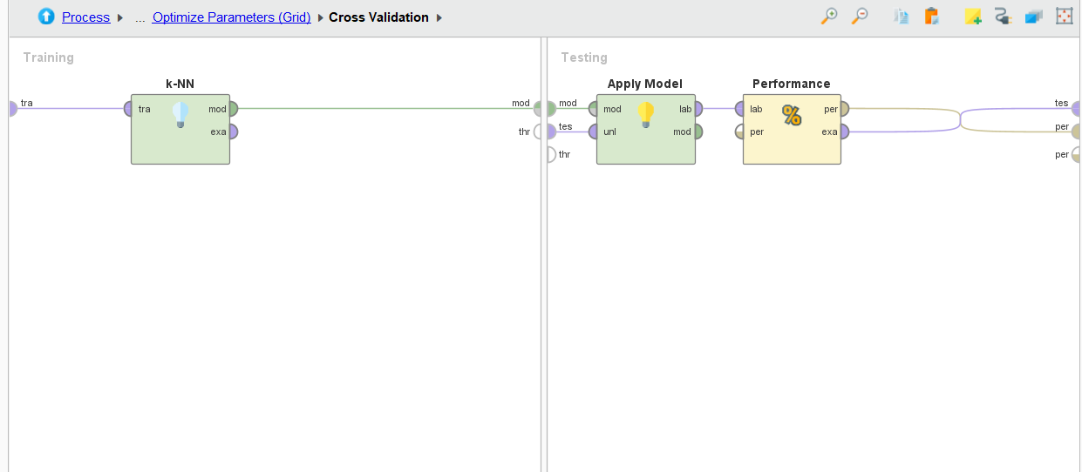
Build Model (kNN)
The k-NN classification model was built in RapidMiner using the following process:
k-NN Algorithm:
Cross Validation: Used to split the data for training and testing.
Optimize Parameters (Grid):
kMin: 2, kMax: 10
Accuracy: Performance metric for evaluation.
Steps:
Training:
k-NN operator applied on training data.
Target attribute: BIKE_COST_CLASS (Low, Medium, High).
Testing:
Apply model on test data using the Apply Model operator.
Evaluation:
Performance measured using Accuracy metric.
Process Diagram:
Training: k-NN and Cross Validation.
Testing: Apply Model and Performance Evaluation.

Slide 35
Access Model/Interpretation (kNN)
Accuracy: The k-NN model achieved an accuracy of 45.07%, which is a moderate performance when predicting the bike theft categories (Low, Medium, High). This shows the overall success of the model in correctly classifying theft cases based on the features.
Precision and Recall (by Class):
Medium Class:
Recall: 62.10%, meaning that 62.10% of the actual medium-cost bikes were correctly identified. This shows the model is relatively good at identifying medium-cost bikes.
Precision: 44.60%, indicating that when the model predicted a bike as medium-cost, it was correct 44.60% of the time.
High Class:
Precision: 51.77%, showing that when predicting high-cost bikes, the model was accurate 51.77% of the time.
Recall: 39.84%, meaning that 39.84% of the actual high-cost bikes were correctly predicted.

Slide 36
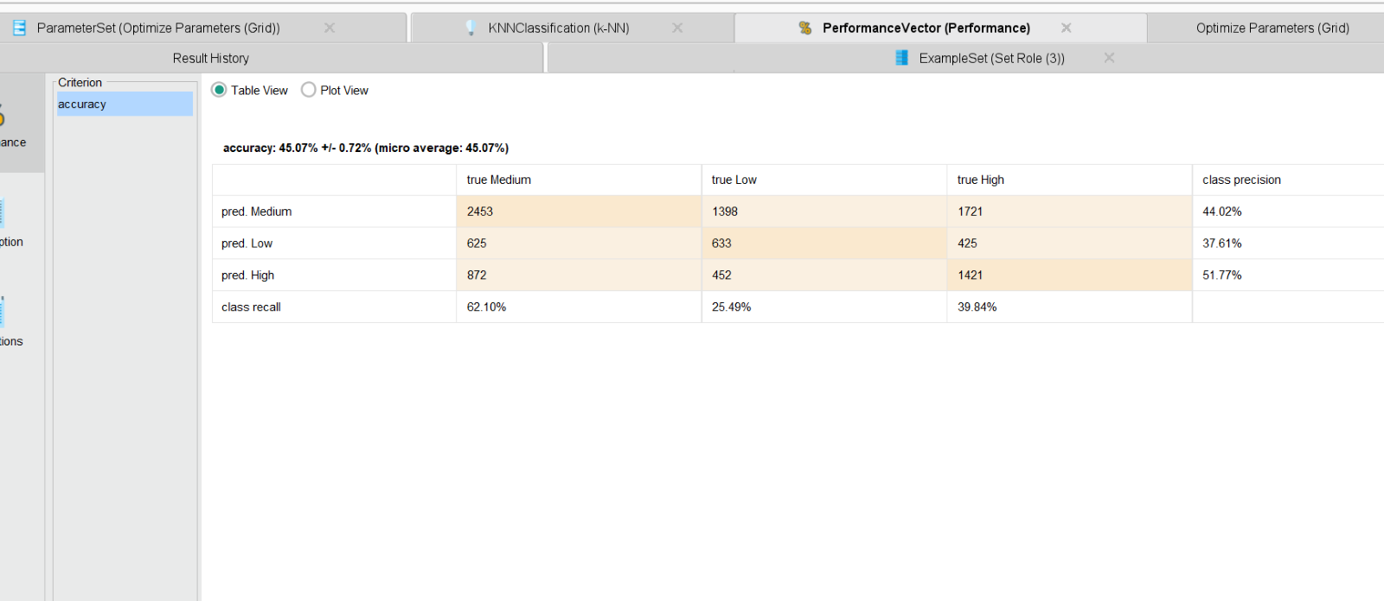
Access Model/Interpretation (kNN)
Low Class:
Precision: 37.61%, meaning that only 37.61% of the low-cost bike predictions were accurate.
Recall: 25.49%, indicating the model had difficulty correctly predicting low-cost bikes, with only 25.49% of the actual low-cost bikes identified.
Confusion Matrix: The confusion matrix provides a deeper view of how well the k-NN model is performing by showing where misclassifications occurred. For instance, a large number of low-cost bikes were misclassified as medium-cost, leading to lower performance in low-cost bike classification.

Slide 37
6.0 Discussion of Results [kNN]
Model Outputs vs. Business Goals
k-NN model successfully identified high-risk areas and peak theft times.
Classified bikes into Low, Medium, and High cost categories, aligning with crime prevention goals.
Outputs support effective resource allocation to high-risk zones.
Key Metrics
Precision (High-cost bikes): 51.77% precision, accurately identifying high-value bikes likely to be stolen.
Recall (Medium-cost bikes): 62.10% recall, successfully identifying most medium-cost thefts, aiding prevention efforts.
Recall (Low-cost bikes): 25.49% recall, struggling to identify low-cost bike thefts, highlighting the need for further model refinement.

Slide 38
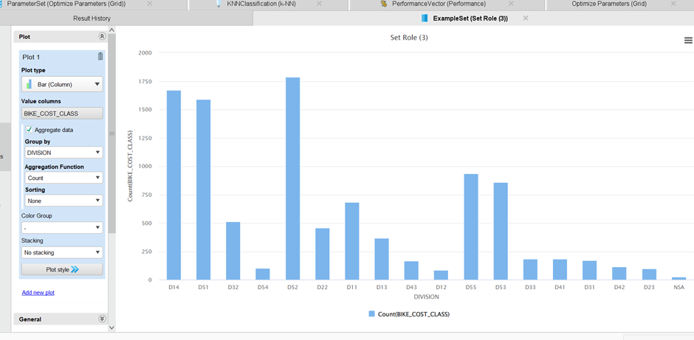
Evaluation of Results (kNN)
Division Analysis (High-Density Areas):
High-risk divisions like D51, D52, and D14 in downtown Toronto consistently recorded the highest thefts across all cost categories. These areas are high-traffic zones, which increases theft opportunities. The presence of valuable bikes in these areas further amplifies the likelihood of theft, making these divisions key focus areas for crime prevention.

Slide 39
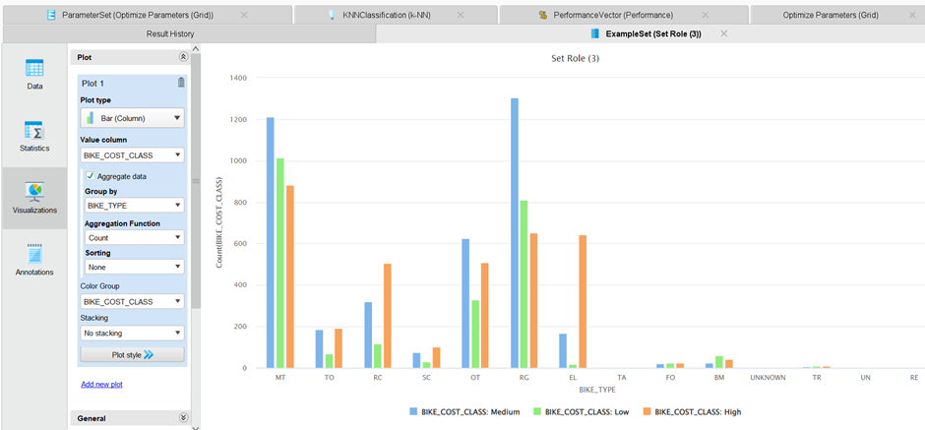
Evaluation of Results (kNN)
Bike Type Trends:
Mountain Bikes (MT) and Road/Gravel Bikes (RG) were the most frequently stolen types, especially in the High and Medium-cost categories. These bikes dominate thefts during peak seasons, such as Summer, showing that bike type is a strong indicator of theft risk. This emphasizes the importance of incorporating bike type as a key feature in the model, as certain types of bikes are more likely to be targeted.

Slide 40
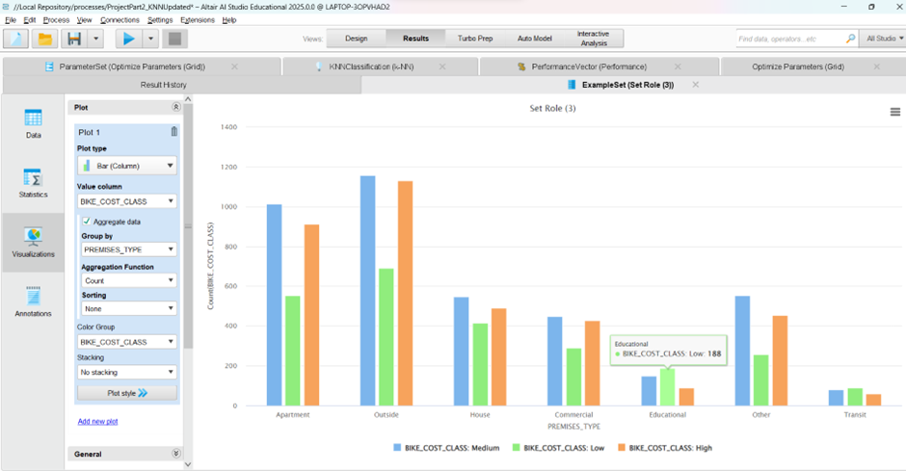
Evaluation of Results (kNN)
Premises Type vs. BIKE_COST_CLASS:
Outside areas saw the most thefts, followed by Apartments and Houses, suggesting that public spaces are more prone to high-cost bike thefts due to easy access. In contrast, Educational and Transit locations had the least thefts, which could be attributed to lower bike values in these locations. This insight can be used to further optimize the kNN model by associating cost categories with likely theft locations.

Slide 41
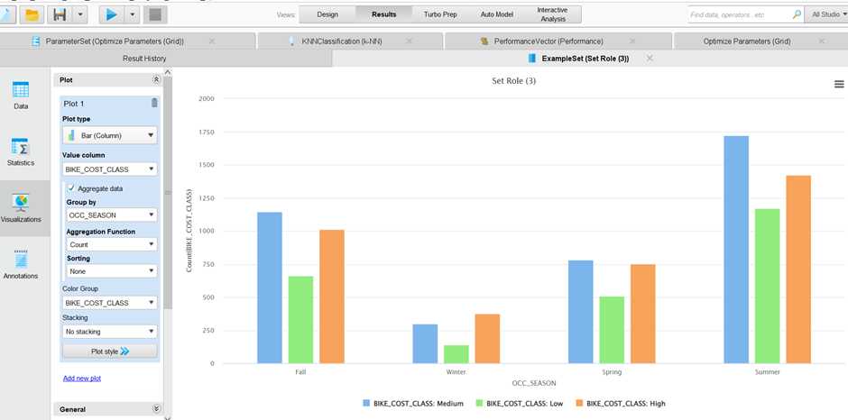
Evaluation of Results (kNN)
Seasonal Patterns:
Summer was identified as the peak season for bike theft, especially for High and Medium-cost bikes. The model showed a significant decrease in thefts during the Winter, aligning with reduced bike usage during colder months. The OCC_SEASON feature in the kNN model proved to be a strong predictor of theft risk, especially for High-value bikes during the warmer months.

Slide 42
Evaluation of Results (kNN)
Compare Model Outputs to Business Goals
Do Predictions Match Expected Theft Trends?
The k-NN model's predictions align with the expected theft trends observed in the data:
High-risk divisions (D51, D52, D14) in downtown Toronto were accurately identified by the model, highlighting areas with the highest theft activity.
Seasonal Trends were well-captured, with Summer being the peak season for bike thefts, especially for High and Medium-cost bikes, confirming expected theft patterns.
The model also reflected bike type trends, identifying Mountain Bikes and Road/Gravel Bikes as the most stolen, particularly in the High and Medium-cost categories.
Assess Key Metrics
For Classification (k-NN):
Accuracy: The model achieved an accuracy of 45.07%, indicating moderate success in predicting bike theft categories (Low, Medium, High).
Precision:
High-cost bikes had a precision of 51.77%, showing that when the model predicted high-cost bikes, it was accurate 51.77% of the time.
Medium-cost bikes had a recall of 62.10%, meaning the model successfully detected most medium-cost thefts.
Low-cost bikes had the lowest precision (37.61%) and recall (25.49%), indicating difficulty in predicting low-cost bike thefts accurately.

Slide 43
Evaluation of Results (kNN)
Surprise Findings
Low-cost Bike Struggles: A surprising finding was the low recall for low-cost bikes (25.49%), showing the model’s difficulty in correctly identifying these thefts. This suggests that low-cost bikes are frequently misclassified, possibly due to overlap in features with other categories or insufficient distinguishing features.
High-Risk Locations: The model’s accurate prediction of high-risk theft areas (D51, D52, D14) aligns with the business goal of crime prevention, confirming that location is a key feature for theft prediction.
Impact of Seasonal Patterns: The model's ability to capture seasonal theft trends, especially the peak in Summer, was a key strength. This aligns with the business goal of anticipating theft patterns based on weather-related factors.

Slide 44
Review Process (kNN)
The k-NN model's performance was evaluated based on its ability to classify thefts accurately across different cost categories. This was done by:
Independent Evaluation:
Testing k-NN with varying k values to assess the optimal model.
Using 10-fold cross-validation to ensure model consistency and reduce overfitting.
Filtering Based on Accuracy:
The model was evaluated based on accuracy and class-level metrics (e.g., precision and recall).
Pattern Review:
After testing, patterns were reviewed based on theft location, bike type, and season to assess why certain thefts were easier or harder to predict.

Slide 45
Review Process (kNN)
Model Strength:
Accurately identifies high-risk areas and high-cost bike thefts.
Model Weakness:
Struggles with classifying low-cost and medium-cost bikes.
Low-cost bikes have the lowest recall and precision, making it harder to accurately predict thefts in this category.
Challenge:
Imbalanced categories in the data lead to reduced recall for low-cost thefts.
Low-cost bikes are often misclassified as medium-cost due to overlap in features, making it difficult for the model to differentiate.
Biases:
Feature Bias: Certain features like bike type and location may dominate the classification process, overshadowing the ability to identify patterns in low-cost thefts.
Data Bias: Missing or underreported theft incidents, particularly for low-cost bikes, skew the model’s predictions and lead to misclassification in those areas.
Future Improvements:
Incorporate more diverse data sources, such as weather conditions, police reports, or events, to improve predictions for underrepresented categories like low-cost bikes.

Slide 46
Next Steps (kNN)
If models perform well:
Prepare for deployment:
Integrate the k-NN model into crime prevention dashboards to provide real-time insights into theft hotspots, allowing authorities to allocate resources effectively in high-risk zones.
If issues exist:
Improve data collection:
Obtain more detailed theft reports, including weather conditions, event data, and demographic information to enhance model accuracy and better capture patterns that influence theft.
Refine models:
Experiment with different hyperparameters or try alternative techniques, such as Random Forests or Decision Trees, to improve recall and precision, especially for low-cost bikes.
Reassess business objectives:
If the model’s insights don’t align with expectations, revisit business goals and adjust the model or data inputs to better support crime prevention strategies and meet the intended objectives.

Slide 47
Decision Tree & Random Forest

Slide 48

4.0 Data Preparation (DT & RF)
This section will include:
What data was chosen
What attributes were constructed
What attributes were formatted

Slide 49
Data Selected (DT & RF)
This was the relevant data selected for the DT & RF:
Attribute | Description | Relevance
BIKE_COST_CLASS | Categorizes bike cost into “Low” “Medium” “High” | Used to predict correlation between cost and theft
OCC_MONTH | What month the theft occurred in | Used to determine whether theft happened in/out of covid years
OCC_DOW | What day of the week theft occurred in | Determine weekday/weekend
OCC_DAY | What day of month (1-30(31)) theft occured | Determine early/mid/late month
OCC_HOUR | What hour of day (1-24) theft occured | Determine morning/afternoon/evening/night
STATUS | Whether bike stolen, recovered, unknown
PREMESIS_TYPE | What location the theft happened at
BIKE_TYPE | What type of bikes were stolen | Used to categorize more accurately the premises type

Slide 50
Data Constructed (DT & RF)
These were the attributes constructed from the selected data:
Attribute | Description | Source Attribute(s)
BIKE_TARGET | Groups bikes based on how popular of a target they are | BIKE_TYPE
DAY_PART | Breaks day into Morning, Afternoon, Evening, Night | OCC_HOUR
WEEK_PART | Breaks week into Weekday or Weekend | OCC_DOW
MONTH_PART | Breaks month into Early-Month Mid-Month and Late-Month | OCC_DAY
DAY_PART | Breaks the hour theft occurred into Morning, Afternoon, Evening, Night | OCC_HOUR
VIOLENT_CRIME | Breaks theft into VIOLENT or NONVIOLENT categories | PRIMARY_OFFENCE
COVID_LOCKDOWN | Determines whether theft happened during covid lockdown or not | OCC_MONTH & OCC_YEAR

Slide 51

Data Formatted (DT & RF)
These were the attributes formatted from the selected data
Attribute | Description | Relevance
BIKE_TYPE | Named convered from two letter abbreviations (MT, RD) to names that made logistical sense (Mountain Bike, Road Bike, etc.) | Make interpreting data much more intuitive

Slide 52
5.0 Modelling (DT & RF)
This section will include:
Model test designs
Model Generation
Model Access (Interpretation)

Slide 53
(DT & RF) Testing/Design
Two Phases: Testing & Training
Training: Model is trained on most of dataset
Testing: Model is tested against small portion of untrained dataset
Nominal cross-validation operator used for both DT’s & RF’s
By default, uses 90%/10% training/testing ratio
Was testing 10 times (default)

Slide 54
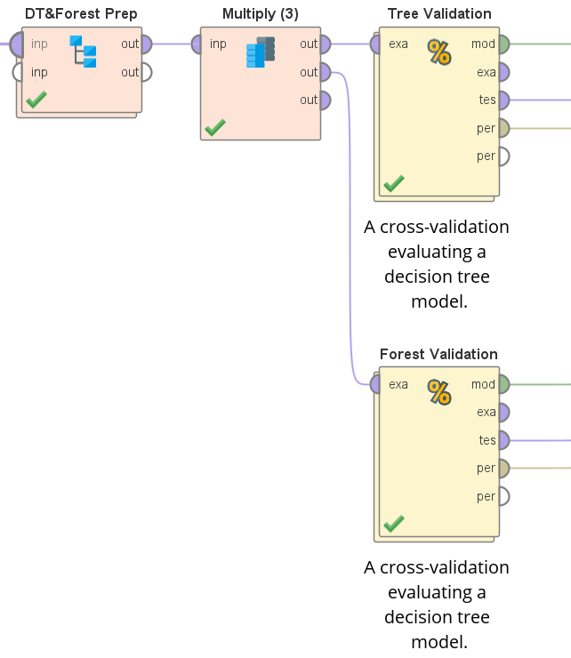
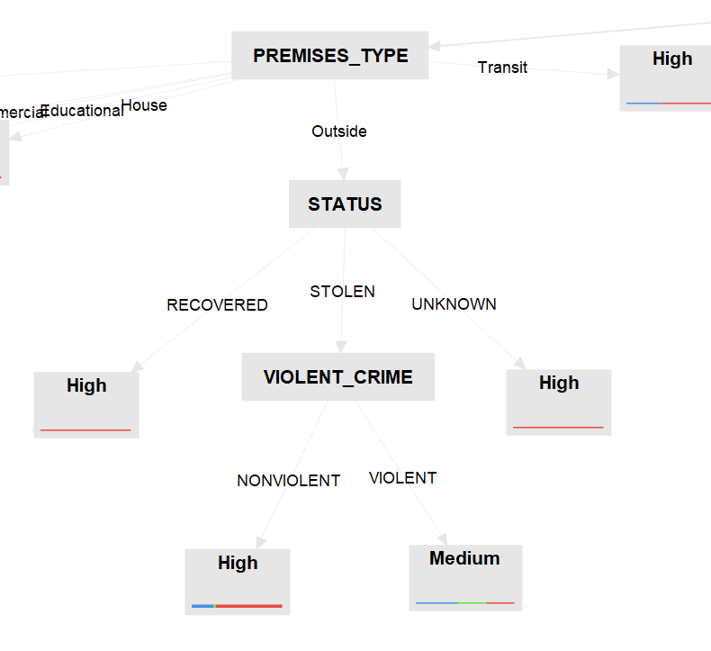
Build Model (DT & RF)
This section will include:
Process flow from AI Studio
Output from DT

Slide 55
Access Model/Interpretation (DT & RF)
Decision Tree & Random Forest (50-Tree Subset) was generated
Both DT & RF producted similar accuracy reading (46.37% & 46.37% respectively)
Interestint Findings/Rules found from DT:
For the most common targets for bicycle theft in Toronto, the vast majority of the bikes recovered were those that had a high value
Violent crimes were more common for stolen electric bikes that had a medium cost when the PREMESIS_TYPE was outside
For Unknown/Other bike targets, during covid, bike thefts that occurred in the morning & afternoon more often resulted in the theft of medium value bikes, where bike thefts that occurred in the evenings & nights more often resulted in the theft of high value bicycles.

Slide 56
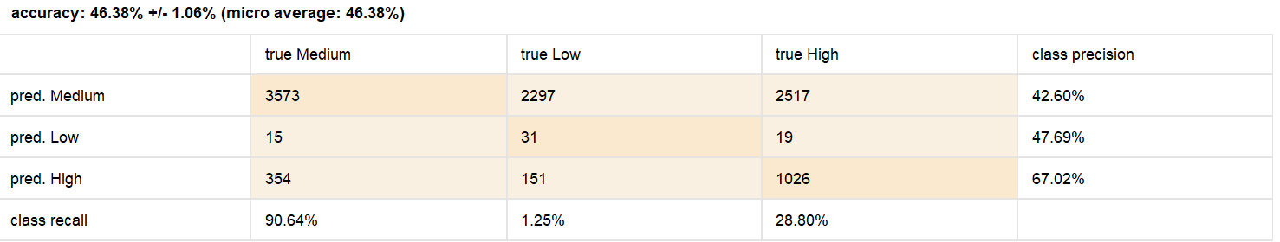
6.0 Discussion of Results (DT & RF)
This section will include:
Evaluation of Results
Review Process
Next Steps

Slide 57
Evaluation of Results (DT & RF)
Model Outputs vs. Business Goals?
Model successfully pinpointed high-risk locations and peak theft times, which directly coincided with out business goals
Key Metrics
Model very good at predicting high-cost bikes due to high precision of 67.02%
Model’s recall for low-cost targets was only 3.7%, indicating difficulty in correctly identifying low-theft areas
For Anomaly Detection: False positives vs. true anomalies

Slide 58
Review Process (DT & RF)
Model Strength: Accurately identifies high-risk cases.
Model Weakness: Struggles with medium and low-risk classification.
Challenge: Imbalanced theft risk categories reduced recall for low-risk cases.
Future Improvements:
Incorporating external/expanding datasets, such as police reports or weather conditions, to enhance predictive power.

Slide 59
Next Steps (DT & RF)
Focus on improving classification performance and expanding data sources.
Incorporate external crime data and refine feature engineering to capture theft patterns.
Conduct further evaluation with real-world data and stakeholder feedback for actionable insights.

Slide 60
Clustering

Slide 61
4.3 Data Preparation (Clustering)
Clustering in Bicycle Theft Analysis
Definition:
Unsupervised machine learning technique that groups similar data points based on shared characteristics.
Goal:
Identify patterns without predefined labels.
Application:
Group bicycle theft incidents based on location, time, and types of stolen bicycles.

Slide 62
Data Selected (Clustering)
Relevant data selected for the Clustering:
Attribute | Description | Relevance
OCC_YEAR | Useful for detecting long-term trends | relevant
OCC_MONTH | Captures seasonal trends | relevant
OCC_DOW | Helps identify day of the week theft occurred | relevant
OCC_DAY | Helps identify daily trends | relevant
OCC_DOY | Helps track yearly theft patterns | relevant
OCC_HOUR | Critical for spotting peak theft times | relevant
DIVISION | Helps identify the division where the theft occurred | relevant
PREMISES_TYPE | Helps understand the theft context | relevant
BIKE_TYPE | Helps identify the bike type | relevant
BIKE_SPEED | Helps to identify speed of the bicycle | relevant
BIKE_COST_CLASS | Class label changed to regular | relevant

Slide 63
Data Constructed (Clustering)
No new attribute were created.
No integrating of data was done.

Slide 64
Data Formatted (Clustering)
Set Attribute:
BIKE_COST_CLASS set to Regular.
Selected Relevant Attributes:
OCC_YEAR, OCC_MONTH, OCC_DOW, OCC_DAY, OCC_DOY, OCC_HOUR, DIVISION, BIKE_TYPE, BIKE_SPEED, BIKE_COST_CLASS and PREMISES_TYPE.
Normalization:
Applied Z-transformation to numerical attributes: BIKE_SPEED, OCC_DAY, OCC_DOY, OCC_HOUR, and OCC_YEAR.
Categorical Variables Conversion:
Converted DIVISION, LOCATION_TYPE, OCC_MONTH, PREMISES_TYPE, BIKE_TYPE, and OCC_DOW to numerical values for clustering.

Slide 65
Modelling (Clustering)
Algorithm:
K- Clustering - an unsupervised machine learning algorithm that groups data into k clusters based on feature similarity.
Use Case:
Identifies theft trends such as common locations, times, and high-risk bicycle types.
Optimal Cluster Selection:
Elbow Method used to determine the best k.
The elbow point (plot of sum of squared distances) indicates the optimal number of clusters.

Slide 66
Generate Test Design (Clustering)
Approach:
Implemented a loop-based clustering in RapidMiner to evaluate different k values.
Process:
Iterated k values from 2 to 10.
Tracked within-cluster sum of squares for each k.
Recorded average within-cluster distance and logged results.
Goal:
Visualized results to determine the elbow point and optimal k.

Slide 67
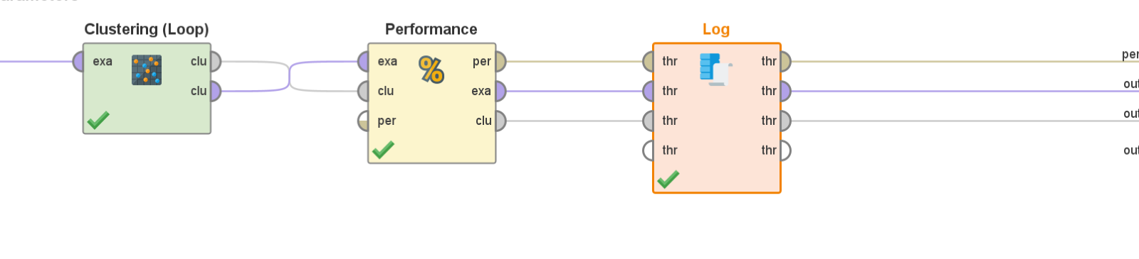
Build Model (Clustering)
Steps:
Standardized relevant numerical attributes for unbiased clustering.
Ran K-Means algorithm within a loop to evaluate performance across different k values.
Used performance metrics such as average within-cluster distance to assess clustering quality.

Slide 68
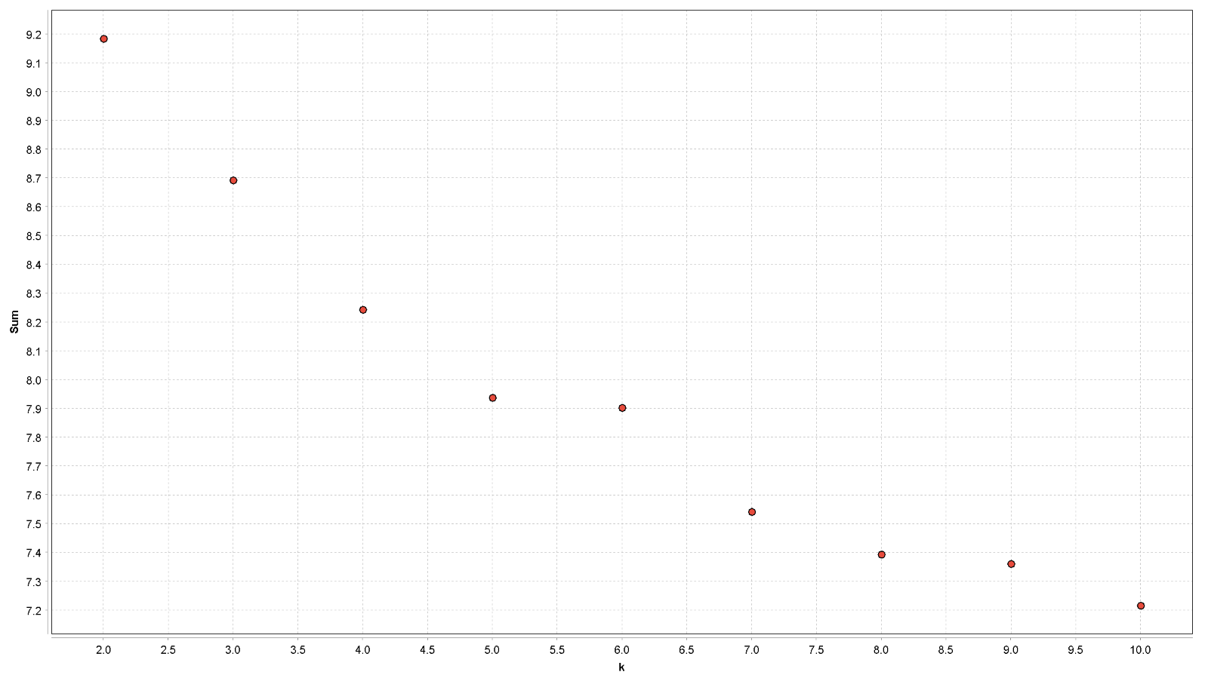
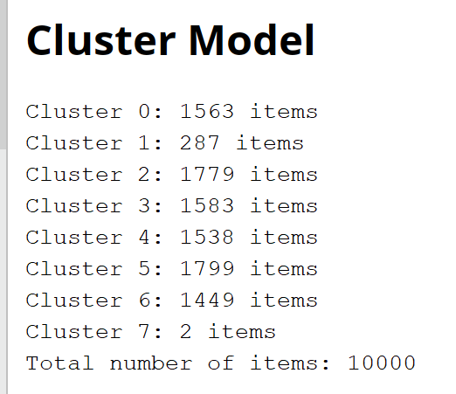
Access Model/Interpretation (Clustering)
Clustering Analysis and Optimal K
The optimal number of clusters (K) was determined using the Elbow Method, where the elbow point was found at K=8 by plotting K against the average within-cluster distance.
The Clustering (best K) operator was applied to generate 8 clusters, providing the most suitable segmentation of the data.

Slide 69
Discussion of Results (Clustering)
Outlier Detection and Clustering Patterns:
Low-Density Cluster - Cluster 7:
Contains only 2 items, identifying rare anomalies.
Includes unusual locations, time periods, or bicycle types.
Confirmed as outlier through clustering with k = 7 and k = 9.
Second Least Populated Cluster – Cluster 1:
Next smallest cluster in best model (k=8), further examined for anomalies.
High-Density Cluster – Cluster 5 (Common Pattern):
Represents the most frequent theft occurrences.
Identifies high-risk locations, times, and common theft methods.
Key of understanding theft patterns and improving preventive measures.

Slide 70
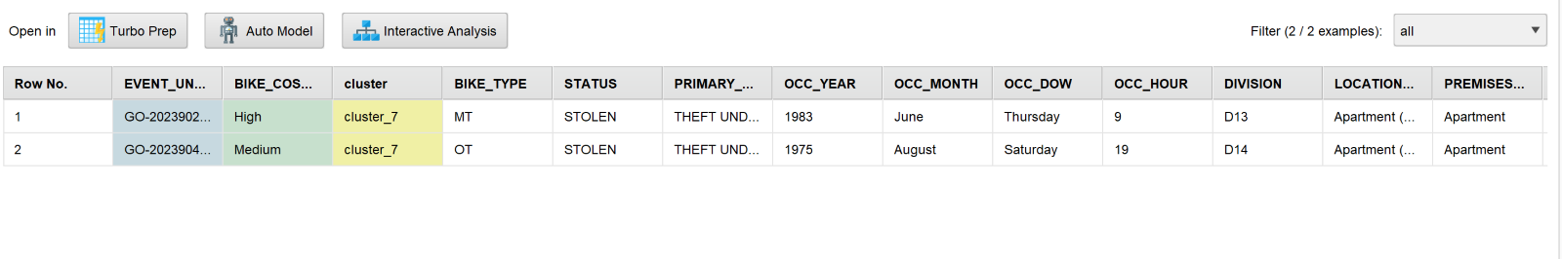
Evaluation of Results (Clustering)
Cluster 7 – Low Density Cluster
Characteristics:
Represents outlier incidents from the years 1983 and 1975, outside the primary timeframe of the dataset (2014-2024).
Low-density cluster, indicating rare occurrences.
Insights:
The inclusion of older thefts (1970s and 1980s) may distort trends in recent years.
These outlier data points are anomalies and don't reflect current theft patterns.
Implication:
The rare occurrence of these incidents makes them stand out from more recent data.

Slide 71
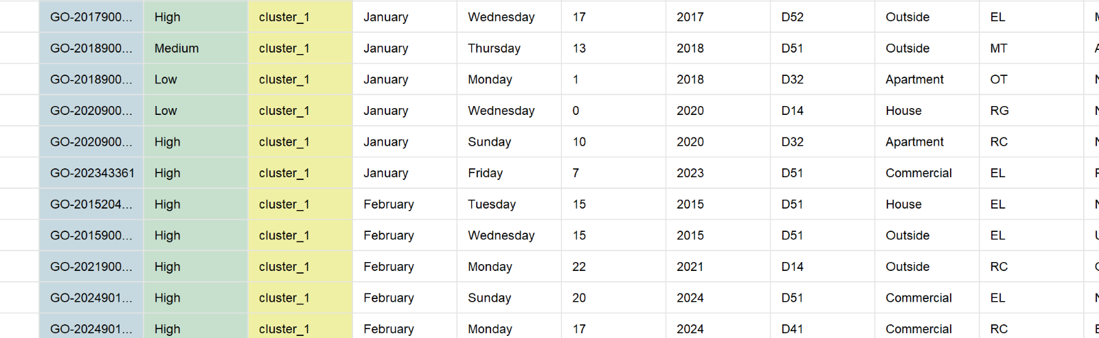
Evaluation of Results (Clustering)
Cluster 1 – Second Least-Populated Cluster
Characteristics:
Represents thefts in January and February.
Insights:
Low frequency of thefts during winter months suggests colder weather and reduced bike usage.
Seasonal Trend:
Theft incidents are less common in colder months, reflecting a clear seasonal pattern.

Slide 72
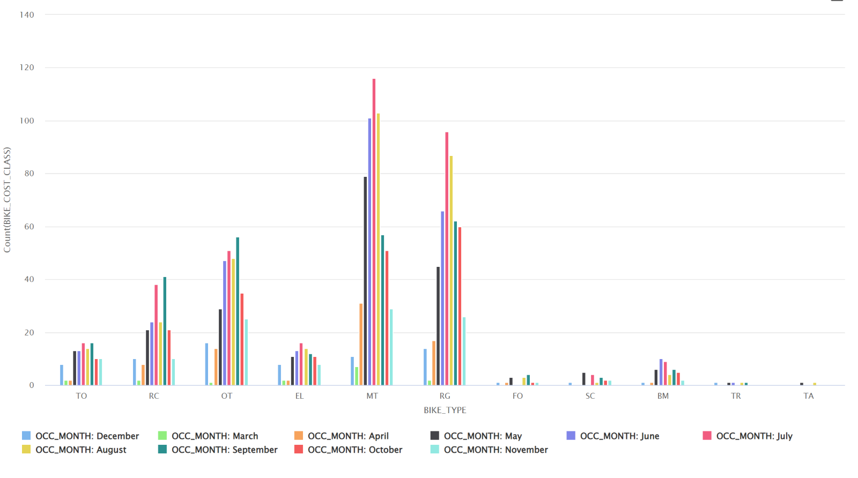
Evaluation of Results (Clustering)
Cluster 5 – High Density Cluster
Frequency of Bicycle Thefts Based on Bike Type and Month.
Key Observations:
Mountain Bikes (MT) and Road Bikes (RG) show the highest theft occurrences across multiple months, indicating they are more frequently stolen.
Theft peaks in July and August, suggesting a seasonal trend linked to increased outdoor activity and bike usage during warmer months.
Winter months (December, January, February) show lower theft rates, likely due to reduced bike usage in colder weather.

Slide 73
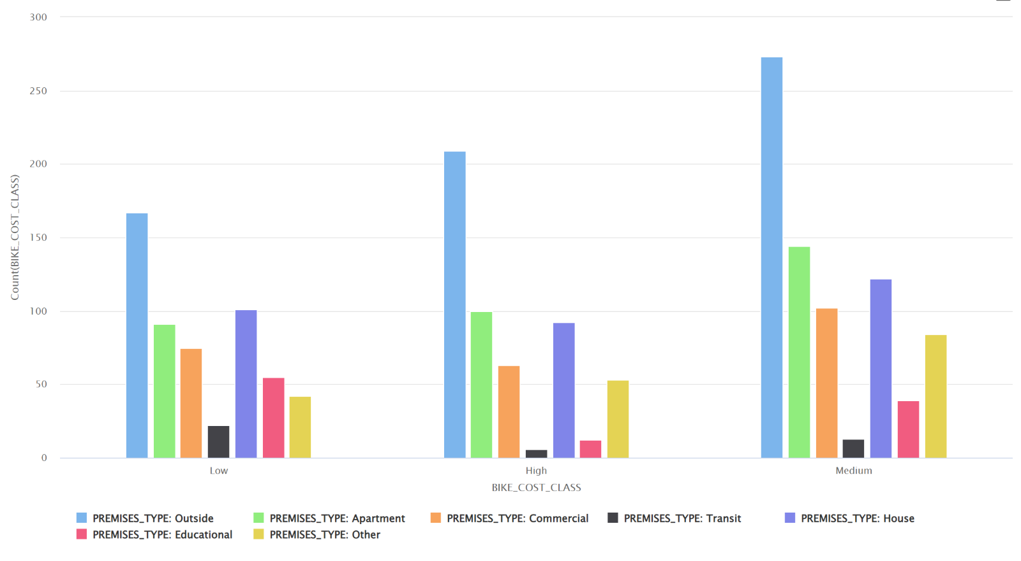
Evaluation of Results (Clustering)
Cluster 5 – High Density Cluster
Frequency of Bicycle Thefts Based on Premises Type and Bike Cost.
Key findings:
Most Thefts occur from outside for low, medium and high-cost bikes, followed by thefts from apartments and houses.
Transit Locations (bus/train stations) and Educational Institutions (school/universities) experience the fewest thefts across all cost categories.

Slide 74
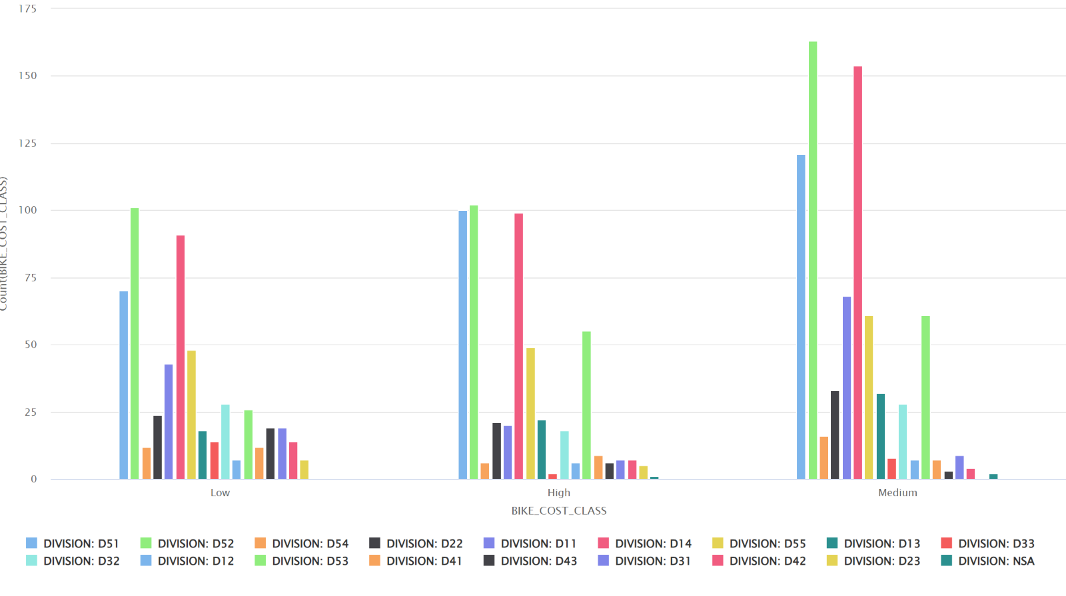
Evaluation of Results (Clustering)
Cluster 5 – High Density Cluster
Bicycle theft occurrence by Bike Cost (Low, Medium, High) and Police Division.
Key observations :
Divisions D51, D52, and D14 have the highest thefts occurrences across all cost categories, indicating higher theft risk in these areas.
Low-Cost Bikes: Most frequently stolen, with D51, D52, and D14 showing the highest incidents.
Medium-Cost Bikes: Also highly targeted, especially in D51, D52, and D14.
High-Cost Bikes: Theft patterns remain consistent, with D51, D52, and D14 having the most cases.

Slide 75
Interpret Results (Clustering)
Outliers Results
Theft Trends by Year
The theft incidents from 1983 and 1975 are outliers in this dataset, as they fall outside the timeframe of 2014-2024. These data points do not follow the same trends as the more recent thefts, suggesting they are anomalies.
The low density of this cluster highlights the rarity of these outlier incidents, which may be due outdated or incomplete data.
Theft Trends by Season
The relatively low number of thefts in January and February reflects a clear seasonal trend.
The winter months show reduced theft activity, likely because fewer people are cycling in colder weather.
This suggests that bike thefts tend to occur more frequently during warmer months when bike usage is higher.

Slide 76
Interpret Results (Clustering)
Common Patterns - Theft Trends by Bike Type, Location, Season, Division, and Cost
Seasonal and Bike Type Trends
Bicycle thefts are influenced by both bike types and seasonal patterns.
Mountain Bikes and Road Bikes are the most frequently stolen, with incidents peaking during the summer months (July and August).
Higher theft rates during the summer when more bikes are in use.
Premises and Theft Location:
The data shows that outside is the most common place for bicycle thefts, regardless of the cost of the bike.
This suggests that bicycles, regardless of value, are often targeted when left outside, possibly due to lack of security measures in public areas.
Least frequent theft locations:
Transit location (like bus station or train stations) and educational institutions (such as school or universities) have the fewest thefts across all cost categories.
This suggests that these areas may have better security measures.
Division trends:
The most frequent bicycle thefts occur in Divisions D14, D52, and D51.
These divisions appear to be high-risk areas for bicycle theft, indicating that there may be a need for increased security measures in these regions to address the elevated theft activity.

Slide 77
Review Process (Clustering)
Clustering Methodology
Used Clustering (Loop) and Clustering (Best K) operators to determine the most suitable number of clusters.
Applied filtering and joining operations were applied.
Insights:
High-density clusters: Indicate common theft trends.
low-density clusters; Highlight rare and potentially anomalous incidents.
Potential Limitations
Cluster Overlap : Some thefts may appear in multiple clusters, reducing clarity.
External Factors not included: Weather, events, and population density not considered.
Data Bias: Missing or underreported incidents could affect cluster validity.

Slide 78
Next Steps (Clustering)
Next Steps for Improving Analysis and Theft Prevention:
Incorporate External Factors:
Analyse weather conditions, public events, and population density on theft trends.
Enhance Security Policies:
Recommend improved lighting, surveillance, and secure bike parking in high-risk areas.
Predictive Modeling:
Implement machine learning models to predict theft risk based on historical patterns.

Slide 79
Outlier Detection

Slide 80
4.0 Data Preparation (Outlier)
Outlier in Bicycle Theft Analysis
Outlier detection is a crucial step in the data analysis process to identify unusual bicycle theft patterns in Toronto.
The goal is to spot unusually high or low bicycle theft cases (based on bike cost, location, and time) that don’t follow normal patterns, helping to find risky hotspots or suspicious thefts.
Imagine we’re tracking bikes in a city, and we find: One bike cost $120,000 while most cost $0–$1,000. It was stolen from a Commercial area. In a division where usually, no thefts happen.

Slide 81
Data Selected (Outlier)
The Relevant Rata selected for the Outlier:
Attribute | Description | Relevance
OCC_MONTH | Month-level seasonality; not selected in final model | Relevant
OCC_DAY | Day of the month; used to find theft patterns. | Relevant
OCC_HOUR | Hour of the day; detects peak theft timing. | Relevant
DIVISION | Used to indicate general location; not in model. | Relevant
LOCATION_TYPE | Redundant due to presence of “PREMISES_TYPE”. | Relevant
PREMISES_TYPE | Where the theft happened, can help in analysis. | Relevant
BIKE_SPEED | Numeric speed indicator of stolen bike. | Relevant
BIKE_COST | Original cost of the bike; included directly in model. | Relevant
LONG_WGS84 | Longitude coordinate; used in outlier model. | Relevant

Slide 82
Data Constructed (Outlier)
The Relevant Rata selected for the Outlier:
Attribute | Description | Source Attribute
LAT_WGS84 | Latitude coordinate; used in outlier model. | Relevant

Slide 83
Clean, Construct, and Integrate Data For Outlier
Clean Data:
Missing data in all attributes was handled by assigning "UNKNOWN” values.
Duplicate records were removed from the dataset.
A check was done for any value issues, ensuing data consistency.
Construct Data:
There was no requirement to derive any new attributes from the existing columns.
Integrate Data:
No integration data.

Slide 84
Format Data For Outlier
Set BIKE_COST_CLASS attribute as Regular, and EVENT_UNIQUE_ID attribute was assigned accordingly.
Select relevant attributes for analysis: BIKE_COST, BIKE_SPEED, DIVISION, LAT_WGS84, LOCATION_TYPE, LONG_WGS84, OCC_DAY, OCC_HOUR, OCC_MONTH, and PREMISES_TYPE.
Normalization: Applied Z-transformation normalization to numerical attributes: BIKE_COST, BIKE_SPEED, LAT_WGS84, and LONG_WGS84.

Slide 85
5.0 Modelling (Outlier)
Unsupervised outlier detection algorithms:
Local Outlier Factor: Detects local anomalies by comparing a point’s density to nearby points.
Isolation Forest: Detects outliers by isolating data points using random trees—outliers are easier to isolate.
Use Case:
Identifies theft trends such as Bike cost, Bike speed, and location.

Slide 86
5.0 Generate Test Design For Outlier
LOF:
Used Detect Outlier Local Outlier Operator with Mixed Euclidean Distance for identifying anomalies by comparing the Local Density of a data point to its neighbors. Points with significantly lower density that their surroundings are classified as Outliers.
Generate Outlier Flag used to generate new column outlier_flag, and next to it change the name to LOF_Outlier.
Filter LOF_Outlier to analysis only LOF_Outlier = Outlier.
ISF:
Used Detect Outlier Isolation Forest for identifying anomalies by randomly participating data points using decision trees; points that get isolated quickly are classified as Outliers.
From new columns Prediction set it as ISF_Outlier using formula: if (prediction >= 0.60, "Outlier", "Normal").
Filter only ISF_Outlier as Outlier for analysis.

Slide 87
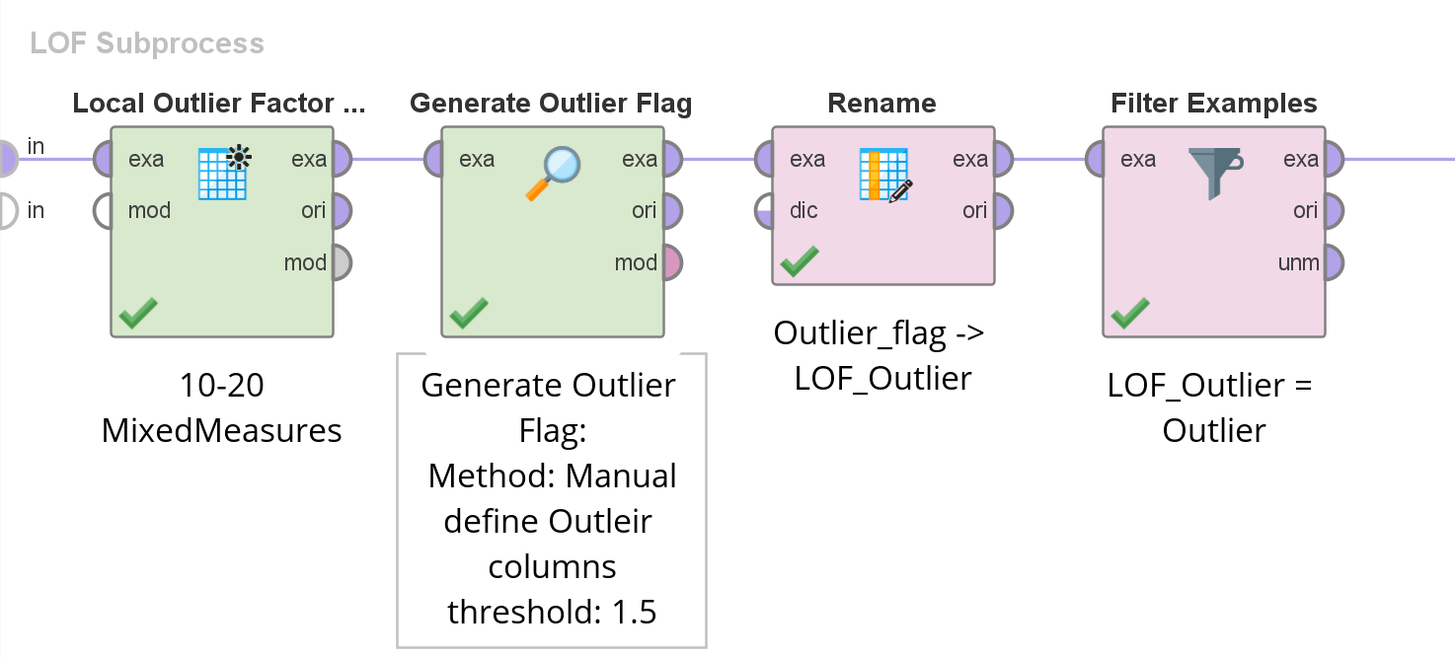
5.0 Build model For Outlier
The outlier detection models were built in RapidMiner using process:
LOF:
LOF Operator: kMin: 10, kMax: 20, Mesuare Type: MixedMesaure->MixedEuclideanDistance.
Generate Outlier Flag: Manual Method, score column: outlier, threshold: 1.5
Rename: outlier_flag->LOF_Outlier
Filter LOF_Oulier = Outlier

Slide 88
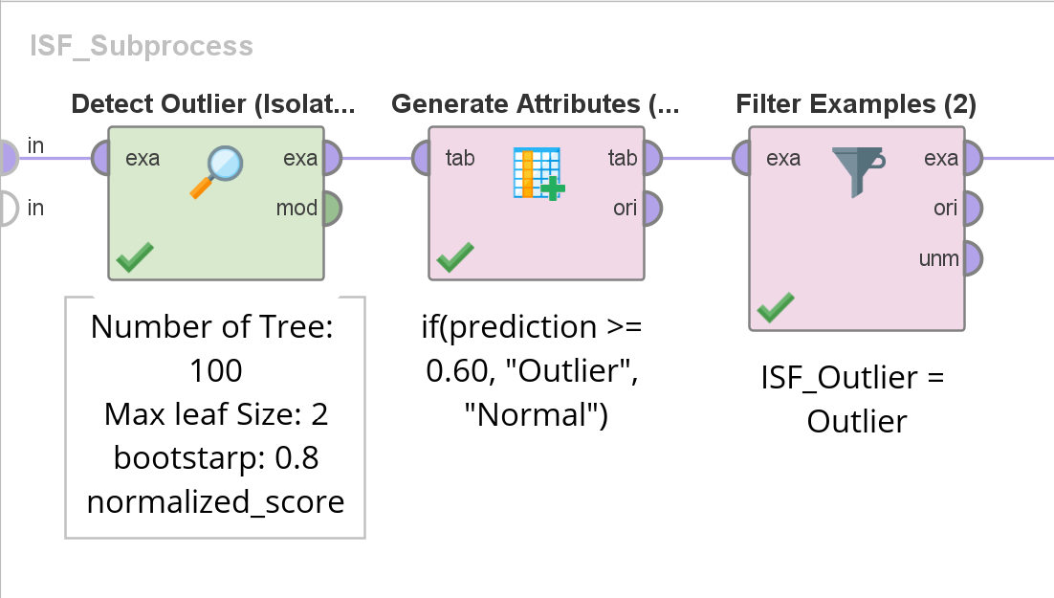
5.0 Build model For Outlier
The outlier detection models were built in RapidMiner using process:
ISF:
Detect Outlier Isolation Forest-> Number of Trees: 100, Max leaf size: 1, bootstrap ratio: 0.9, and socre_calculation: normalized_score, because the more common choice and normalize the score to a range from 0 to 1, which is easier to interpret and typically gives better results when identifying outliers.
Used formula: if (prediction >= 0.60, "Outlier", "Normal") & create new columns from prediction.
ISF_Outlier = Outlier filtered.

Slide 89
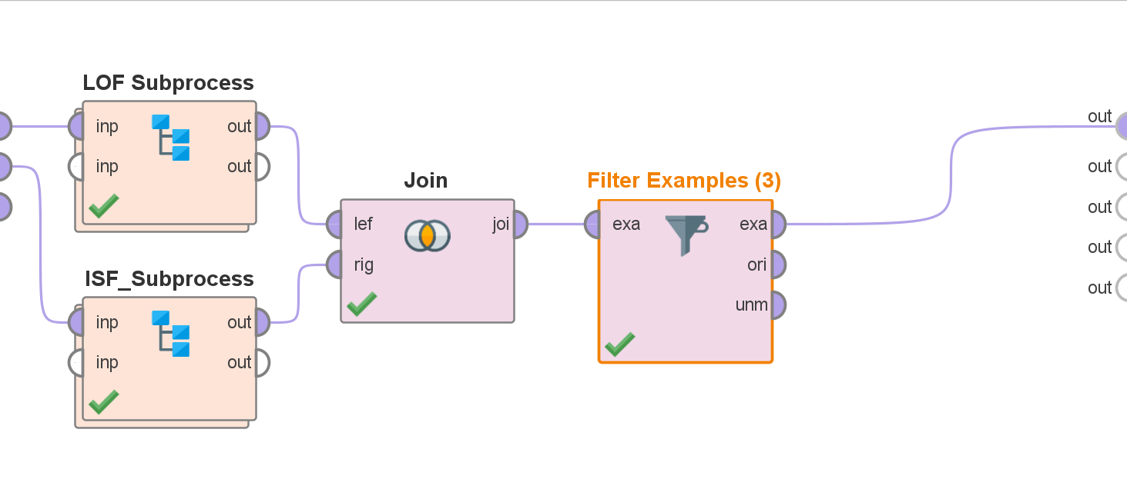
5.0 Build model For Outlier
The outlier detection models were built in RapidMiner using process:
LOF + ISF: When Joining both LOF + ISF Method by id, and filtering only LOF_Outlier = Outlier and ISF_Outlier = Outlier.

Slide 90
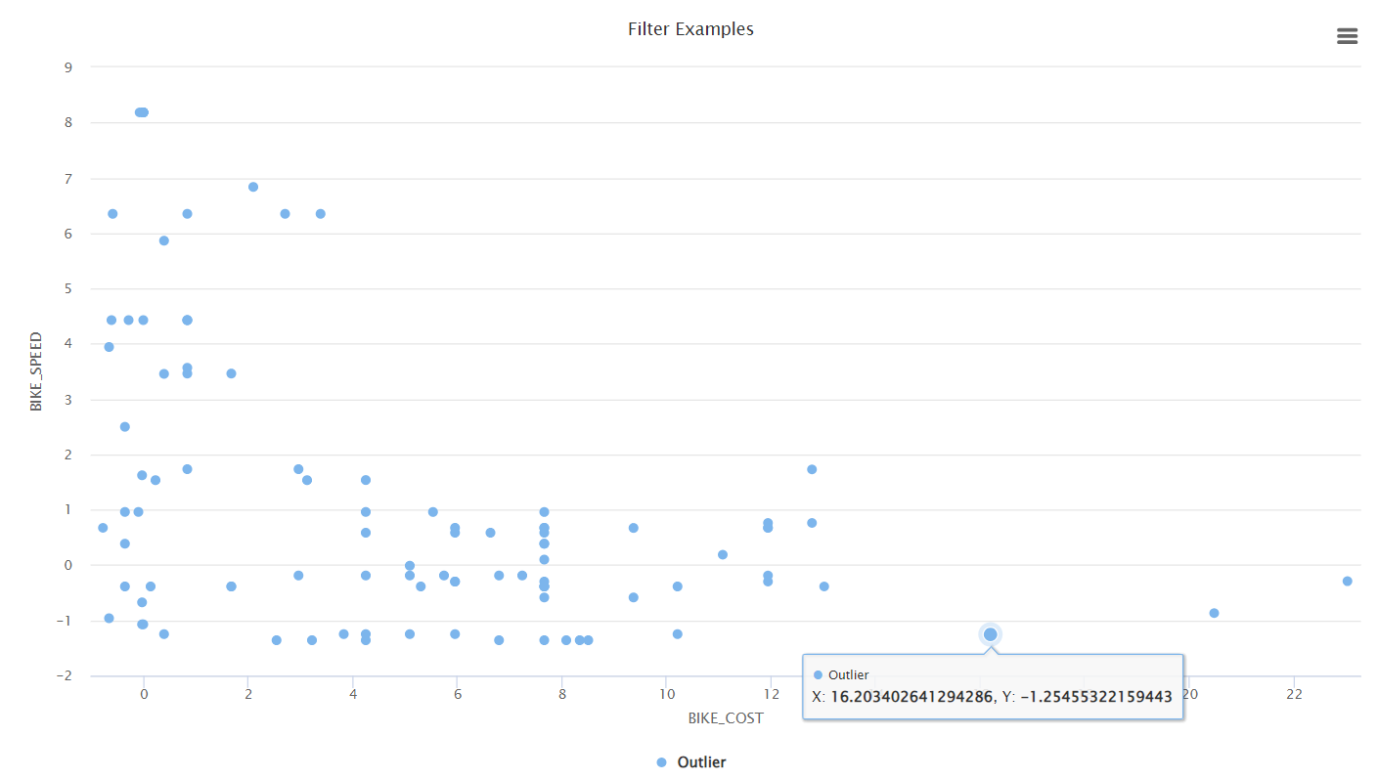
5.0 Access model For LOF Outlier
The outlier detection models were built in RapidMiner using process:
LOF: Could consider these as LOF_Outlier

Slide 91
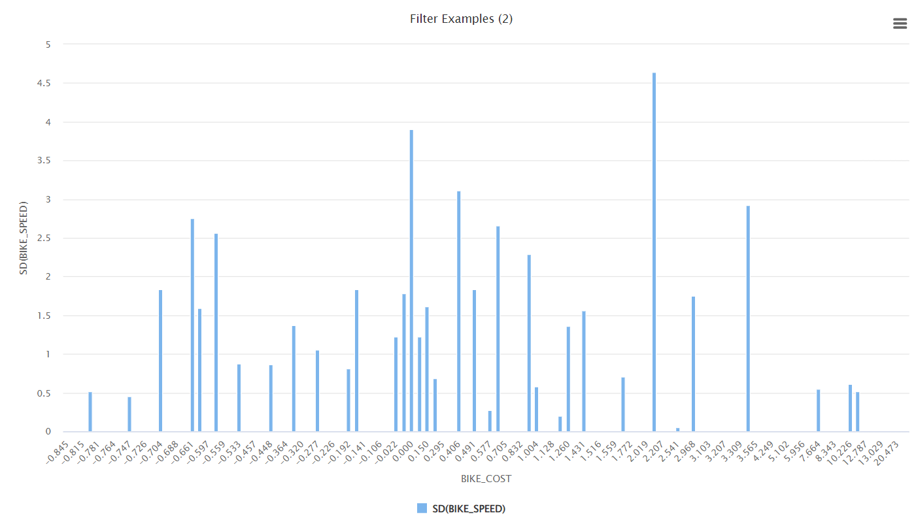
5.0 Access model For ISF Outlier
The outlier detection models were built in RapidMiner using process:
ISF: Could consider as Outlier

Slide 92
Discussion of Results for Outlier
More is not always better. Sometimes too many = too sensitive (false positives), too few = missed anomalies.
Outlier Detection in LOF:
Local Outlier Factor:
Trying with Default Values
Generate Outlier Flag:
Threshold: 0.5 = 10000
Threshold: 1.0 = 8824
1.1 = 2970 (Observation as Threshold high, low number of perfect outlier example.)
1.2 = 1199, 1.3 = 586, 1.4 = 303, 1.5 = 140
Isolation Forest:
Tried different versions for number of trees, max leaf size, and boostrap like 100, [200, 300], 1, [2,3], 0.6, [0.75, 0.8, 0.9, 1.0], best combination was 100, 2, 0.8, respectively.
Set prediction above 0.6 as Outlier, as near to 0 normal and near to 1 Outlier

Slide 93
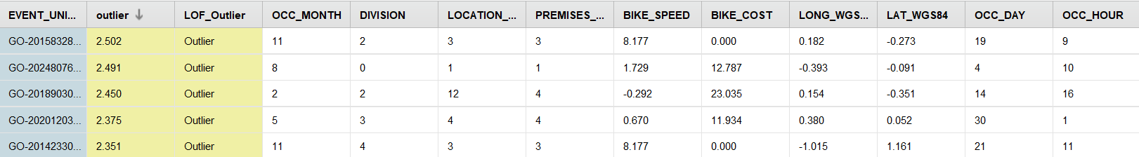
Evaluation of Results for Outlier
Outlier Detection in LOF:
IF BIKE_COST > 6 then Expensive bike
IF BIKE_SPEED > 6 then Very fast bike
IF BIKE_SPEED < 0 then Strange/slow speed
IF OCC_HOUR < -1 then Late-night-time.

Slide 94
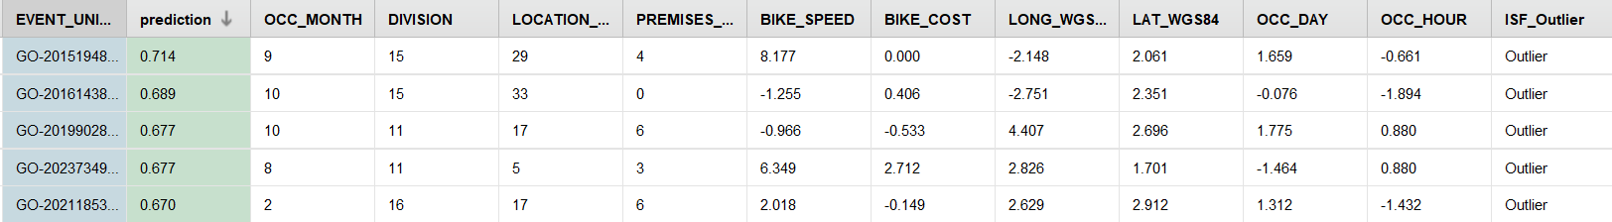
Evaluation of Results for Outlier
Outlier Detection in ISF:
IF BIKE_SPEED > 6 then Very fast bike
IF BIKE_SPEED < 0 then Odd speed
IF BIKE_COST > 6 then Expensive bike
IF OCC_HOUR < -1 then Late night-time
IF LAT_WGS84 > 2 or < -1 then Unusual location

Slide 95
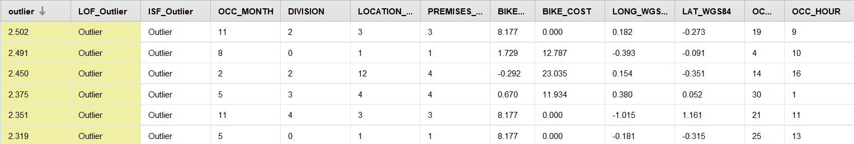
Evaluation of Results for Outlier
Outlier Detection in LOF + ISF:
IF BIKE_SPEED > 6 then Very fast bike
High BIKE_COST (e.g., 23.035, 7.237) then expensive bikes
Very High BIKE_SPEED (e.g., 8.177) then fast bikes
Unusual OCC_HOUR (e.g., -1.894, -1.586) then thefts at night or early morning
Rare Locations (e.g., LAT_WGS84 = 2.755, 2.913) then uncommon areas

Slide 96
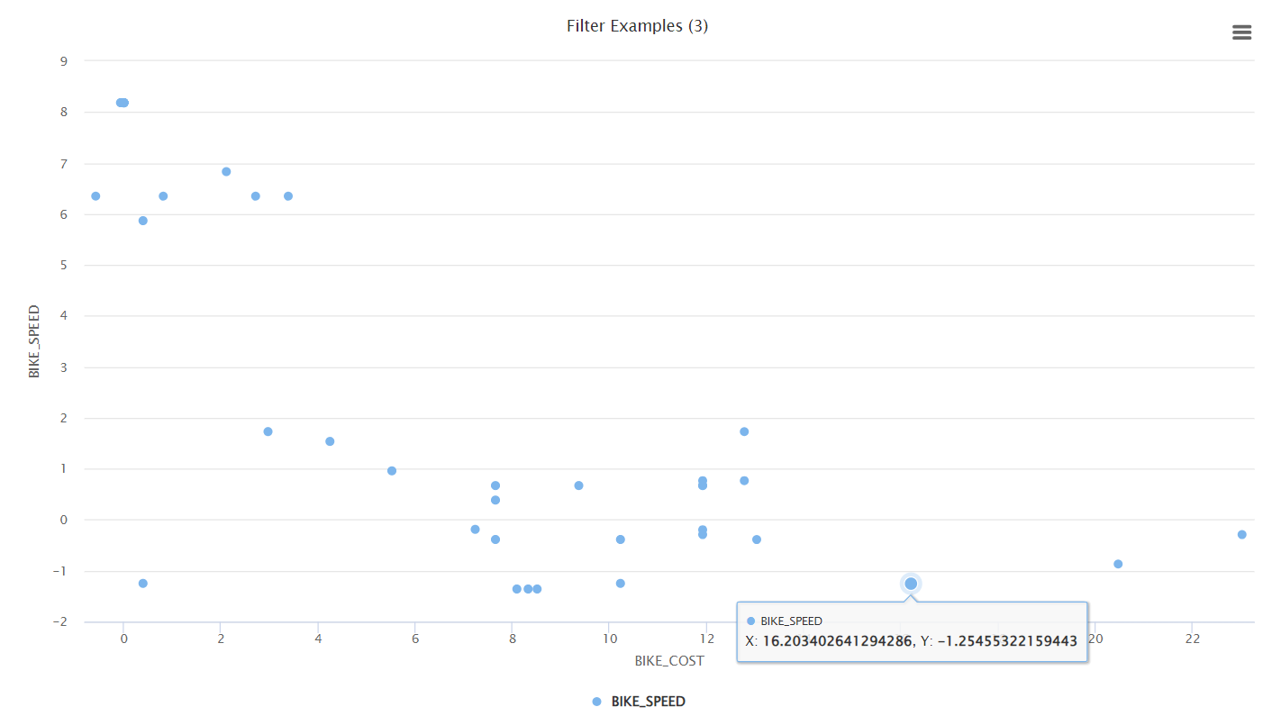
Evaluation of Results for Outlier
The outlier detection models' result output:
LOF + ISF: LOF and ISF Outlier, getting same graph.

Slide 97
Interpret Results for Outlier
Theft Trends by Speed
Several outliers had very high bike speeds, such as 6.349 and 8.177, which stand out from the rest of the dataset. This may suggest unusual activity or potentially incorrect speed entries.
Theft Trends by Cost
Some thefts involved extremely high-value bikes, with costs reaching 7,237 and even 23,035. These bikes are far above the average and may have been targeted specifically due to their value.
Theft Trends by Time
Multiple outlier records had theft times occurring around early morning hours, represented by OCC_HOUR values like 7 in Morning and 3 in night, which is not common in typical theft patterns.
Theft Trends by Location
Outlier events occurred in uncommon or distant locations, as seen from LAT_WGS84 values like 2.913 and 3.255. These locations were far from the typical clusters of thefts and may indicate isolated or special cases.

Slide 98
Review Process for Outlier
The review process involved evaluating the outlier detection results from two different unsupervised machine learning models — Local Outlier Factor (LOF) and Isolation Forest (ISF) — to ensure accuracy and consistency in identifying abnormal theft records.
The process included the following steps:
Independent Model Execution
LOF and ISF were each applied to the dataset using separate subprocesses. Each model generated its own outlier labels based on their unique algorithmic logic.
Filtering Based on Thresholds
LOF outliers were filtered using a threshold of LOF score > 1.5
ISF outliers were filtered using a threshold of Prediction score ≥ 0.60
Joining the Results
The outputs from both models were joined using the unique event ID, and a Filter Examples operator was used to extract only those rows that were marked as outliers by both models.
Manual Review of Outlier Records
The filtered outlier list was manually reviewed to observe patterns in: Bike cost, Speed, Theft time (OCC_HOUR), Location (LAT_WGS84).
Interpretation Based on Patterns
Patterns were then categorized by trends in speed, cost, time, and location to explain why each record was considered an outlier.

Slide 99
Next Steps for Outlier
Next Steps for Improving Analysis and Theft Prevention:
Incorporate Additional Data Sources:
Bring in external datasets such as:
Weather conditions
Holiday or event calendars
Police incident reports
to explore correlations with theft spikes or anomalies.
Improve Data Quality:
Address records with:
Incomplete timestamps
Negative or extreme speed values
Missing or inaccurate locations
This ensures outliers reflect real patterns and not just dirty data.

Slide 100
Next Steps for Outlier
Map Risk Zones Using Outlier Locations:
Use outlier latitude/longitude data to mark high-risk or uncommon theft areas and recommend preventive measures like:
Increased surveillance
Community alerts
Bike locker installation
Develop Predictive Models:
Use historical theft data (and confirmed outliers) to build models that:
Predict future theft hotspots
Alert authorities or users in advance

Slide 101
7.0 Conclusion
Understanding Bicycle Theft Risk in Toronto
Objective:
Analyze bicycle theft risk across Low, Medium, and High-cost classes using location, time, and date.
Key Findings:
High-risk areas and peak theft hours identified through K-Nearest Neighbors (KNN), Decision Trees, Clustering, and Outlier Detection.
Seasonal trends and bike value correlation observed, with higher-cost bike targeted more in certain locations/times.
Outlier detection revealed unusual theft patterns.
Practical Implications:
Cyclists can make informed decisions on safe parking locations and times.
Policymakers can develop targeted prevention strategies, such as increasing patrols or awareness campaigns.

